Slide 1
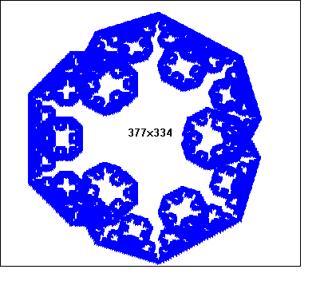
What are fractals?
Demo

Slide 2





What are fractals?
Fractals are Iterated Function Systems( IFS’s ).
Fractals are self-similar geometrical objects.
A fractal is a rough or fragmented geometric shape that can be subdivided in parts, each of which is (at least approx.) a reduced-size copy of the whole. Fractals are generally self-similar and independent of scale.
Sierpinski triangle
Koch edge
Peano curve
Dragon curve
Lorenz attractor

Slide 3
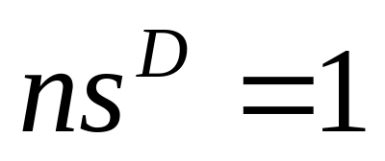
Topological Dimension
Topological dimension (in Euclidean dimension)
Example:
One dimension: Scaling factor: s = 1/n
Divide the line segment into n subparts
(D=1)
Notes:
Affine transformation mentioned earlier is able to "geometricaly" transform part of the image but is not able to transform greylevel of the pixel. new dimension into affine transformation.

Slide 4
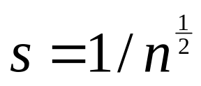
Topological Dimension
Topological dimension (in Euclidean dimension)
Example:
Two dimensions: Scaling factor:
Divide the area into n subparts.
(n=4, s=1/2)
(D=2)
Notes:
Affine transformation mentioned earlier is able to "geometricaly" transform part of the image but is not able to transform greylevel of the pixel. new dimension into affine transformation.

Slide 5
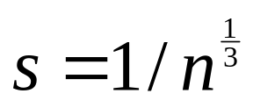
Topological Dimension
Topological dimension (in Euclidean dimension)
Example:
Three dimensions: Scaling factor:
Divide the cube space into n sub-cube space.
(n=8; s=1/2)
(D=3)
Notes:
Affine transformation mentioned earlier is able to "geometricaly" transform part of the image but is not able to transform greylevel of the pixel. new dimension into affine transformation.

Slide 6
Fractal Dimension
Fractal dimension: The amount of detail variation of the object
D = ln(n) / ln(1/s)
Notes:
Affine transformation mentioned earlier is able to "geometricaly" transform part of the image but is not able to transform greylevel of the pixel. new dimension into affine transformation.

Slide 7
Fractal Dimension
Fractal dimension: Example
n = 4
s = 1/3
D = ln4/ln(3) = 1.26
Notes:
Affine transformation mentioned earlier is able to "geometricaly" transform part of the image but is not able to transform greylevel of the pixel. new dimension into affine transformation.

Slide 8
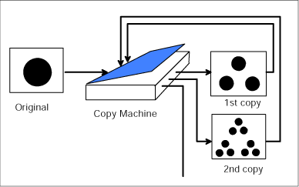
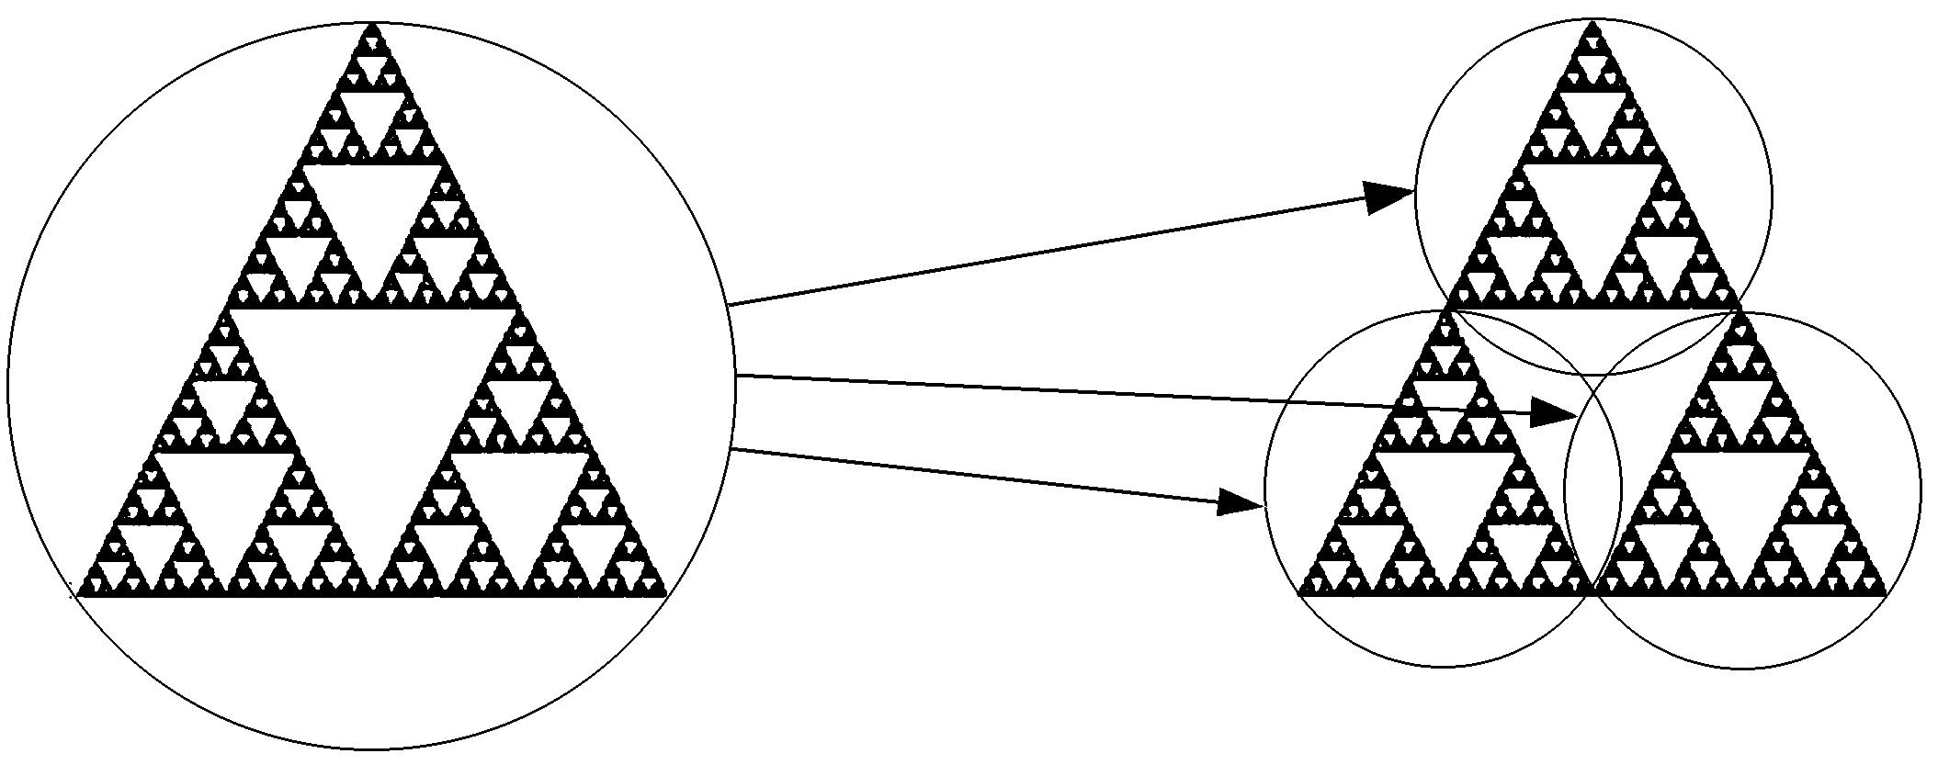
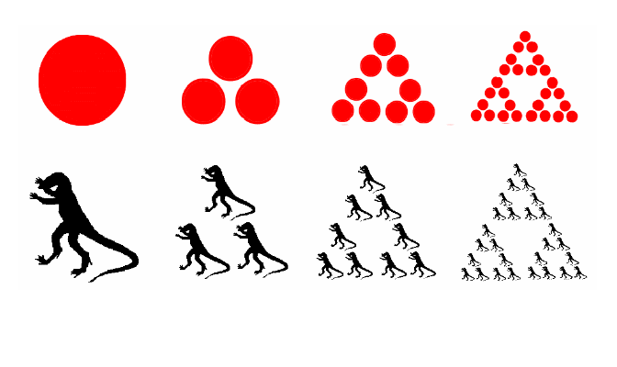
Construction of Fractals
The Sierpinsky Triangle
The final image is called Attractor or fixed point Image
Notes:
According to a famous theorem from the mathematician Banach , the fractal can be constructed
by iterating the same process. Consider a special type of photo copying machine that reduces
the input image by a half and reproduces it three times on the copy. It is obvious that the output
images converge to the Sierpinski triangle. This final image is called attractor for this photocopying
machine. Any initial image (Circle in our case) will be transformed to the attractor if we repeatedly
run the machine. On the other words, the attractor for this machine is always the same image
without regardless of the initial image. This feature is one of the keys to the fractal image compression.

Slide 9

Affine Transformations
The Fractal can be determined by its transformation process.
We call image the attractor of the process.
Different transformations lead to different fractals. In the most cases only a limited type of transformations.
To describe the behavior of the machine, the transformations of type shown will help us.
Affine Transformations are able to skew, stretch, rotate , scale and translate an input image.
Notes:
Different transformations lead to different fractals. In the most cases only a limited type of transformations which do simple things to skew ,stretch,rotate,scale and translate the input image.

Slide 10

IFS (Iterated Function Systems)
Behavior of the photocopying machine is described with mathematical model called an Iterated Function System (IFS).
An iterated function system consists of a collection of contractive affine transformations.
According to Hutchingson’s theorem, given an input image (or set) , we can repeatedly apply W (or photocopying machine described with W) and we will get as a first copy as
And second copy as
The last attractor as
Notes:
For an input set S, we can compute for each i, take the union of these sets, and get a new set W(S).
Hutchinson proved an important fact in Iterated Function Systems: if the are contractive, then W is contractive.

Slide 11
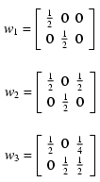
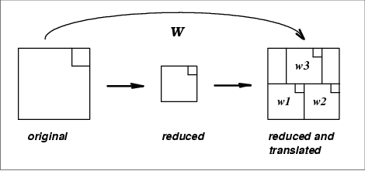
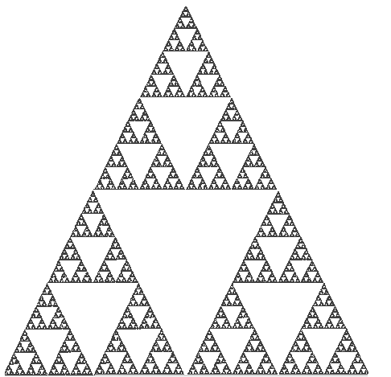
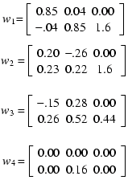
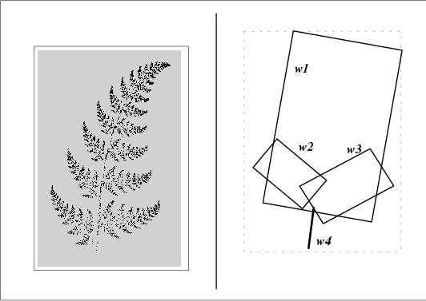
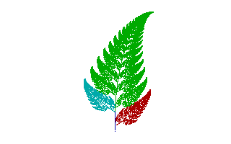
Sierpinski Triangle & Barnsley’s fern
Transform that produces the Sierpinski Triangle.
Barnsley’s Fern
Notes:
w1 controls the overall shape, w2 generates the left leaves, w3 generates the right leaves, and w4 produces the stem.
Given the right software, four transformation just 24 numbers can generate this image. Barnsley’s Fern is not a real
botanical fern, of course, nor is it a picture of one, but it does look like some real ferns. This fact (or coincidence)
offers the first hint that fractals might permit extreme image compression.Applying collage theorem defined previously,
if the union of transformed images is equal to original then only IFS will generate something similar to original.
A human is needed to adjust transformations for such patteren matching. Collage theorem is based on the assumption
that the parts of an image resemble the whole. A fern shown above may resemble the branches , but not he caterpillar
easting on leaves. To capture such things we need different approach PIFS.

Slide 12

PIFS ( Partitioned IFS )
To Capture the diversity of real images
The parts of an image are not miniature versions of the whole but the parts may resemble larger parts.
A system that transforms the similar larger parts to the smaller parts that require a workable strategy.
New dimension into affine transformation.
Where represents the contrast, the brightness of the transformation .
Notes:
Affine transformation mentioned earlier is able to "geometricaly" transform part of the image but is not able to transform greylevel of the pixel. new dimension into affine transformation.

